Slide 1


Slide 2


Slide 3
BOX
Ahmad Sultan

Slide 4
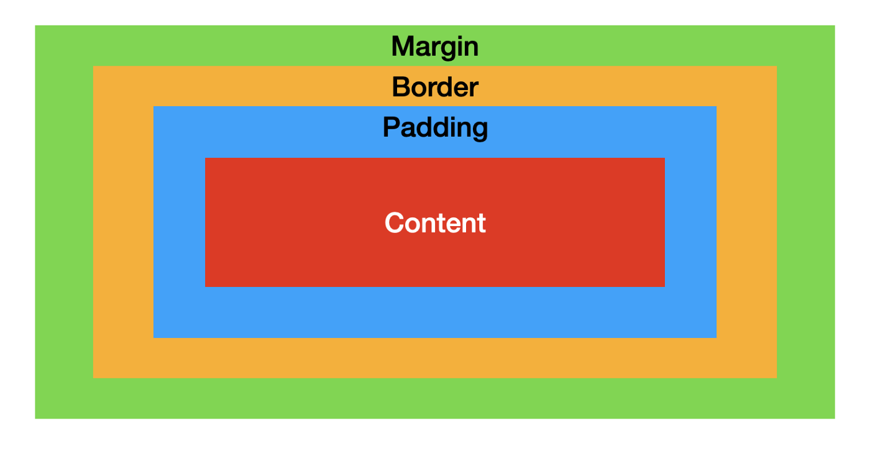
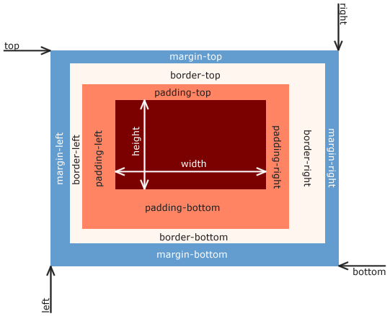

Slide 5
Today Topics
Topics that today we’ll cover are:
Box Dimentions 1) width 2) height
Limiting Width 3) min-width 4) max-width
Limiting Height 5) min-height 6) max-height
Ahmad Sultan

Slide 6
Today Topics
Overflow 1) scroll 2) hidden
Border
Margin
Padding
Outline
Ahmad Sultan

Slide 7

Margin, Border, Padding
you will learn about the following properties:
text Align
Text Align Last
Vertical Alignment
Ahmad Sultan

Slide 8
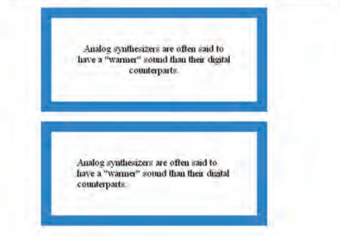
Margin, Border, Padding
you will learn about the following properties:
text Align
Text Align Last
Vertical Alignment
Ahmad Sultan

Slide 9
Border
Border sub properties are:
border-width
border-color
border-style
border (short-hand-property) p { width: 250px; border: 3px dotted #0088dd; }
Ahmad Sultan

Slide 10
Padding
Padding sub properties are:
padding-top
padding-right
padding-bottom
padding-left
padding (Short hand property)
Ahmad Sultan

Slide 11
Margin
Margin sub properties are:
margin-top
margin-right
margin-bottom
margin-left
margin (Short hand property)
Ahmad Sultan

Slide 12
Outline
An outline is a line drawn outside the element's border.
Note:
Outline differs from borders! Unlike border, the outline is drawn outside the element's border, and may overlap other content. Also, the outline is NOT a part of the element's dimensions; the element's total width and height is not affected by the width of the outline.
Ahmad Sultan

Slide 13
Outline
Outline sub properties are:
outline-width
outline-color
outline-style
outline (short-hand-property) p { width: 250px; outline: 3px dotted #0088dd; }
Ahmad Sultan

Slide 14
Display
The display property allows you to turn an inline element
into a block-level element or vice versa, and can also be used to
hide an element from the page.
Display sub properties are:
inline
block
inline-block
none
Ahmad Sultan

Slide 15
Visibility
The visibility property allows you to hide boxes from users
but It leaves a space where the element would have been.
Visibility sub properties are:
hidden
visible
Ahmad Sultan

Slide 16
Thanks!
Ahmad Sultan
Any questions?

